Slide 1
Experiences in Takeda
Wenxuan Deng

Slide 2
Self Introduction
Wenxuan Deng
3rd Year PhD student in Department of Biostatistics, Yale University. (2016-)
Department of Mathematical Sciences, Tsinghua University (2011-2015)

Slide 3
Project
Topic: Patient Subgroup Identification and Predictive Biomarkers Selection
Background: Predictive gene signatures are informative and correlated with response and treatment variable. We want to use multiple statistical methods to fulfill gene selection on high-dimensional genomics data.

Slide 4
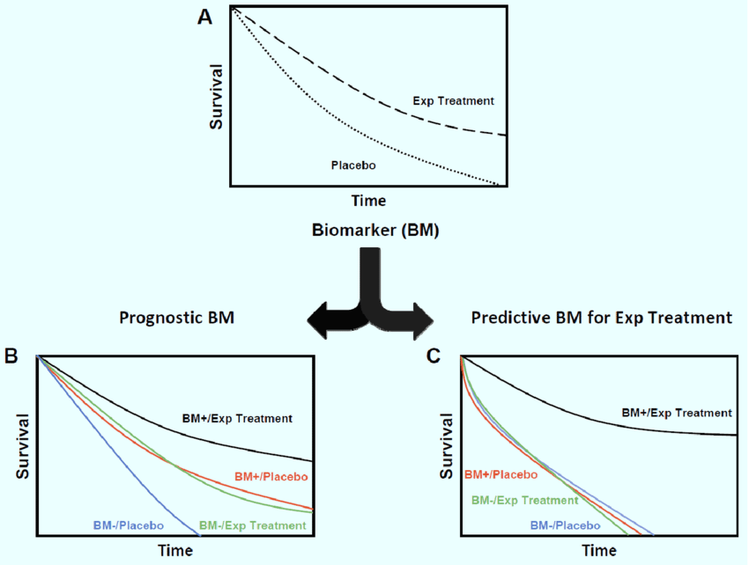
Predictive and Prognostic Biomarkers
T Tran, P., et al. Current molecular medicine 12.6 (2012

Slide 5
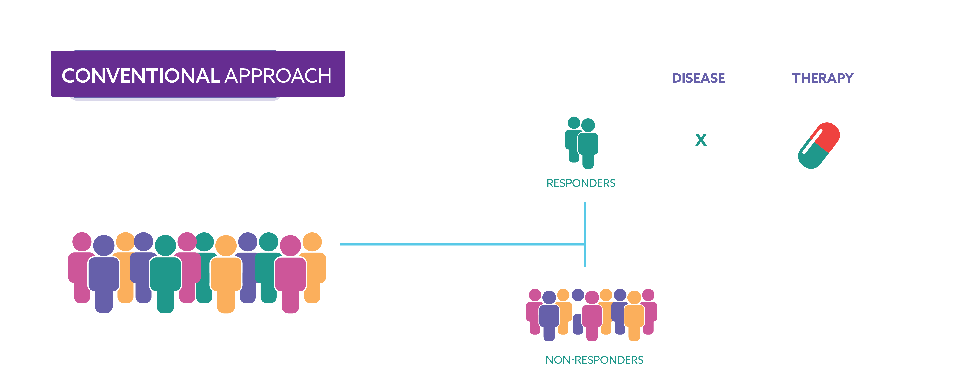
Patient Subgroup Identification
X
X

Slide 6
Experiences
Orientation
Workspace
Collaboration
Activities

Slide 7
Suggestions
More seminars
More networking opportunities with interns from other departments

Slide 8
Thanks!

